Slide 1

Parallel Programming in C with MPI and OpenMP
Michael J. Quinn

Slide 2
Chapter 2
Parallel Architectures

Slide 3
Outline
Interconnection networks
Processor arrays
Multiprocessors
Multicomputers
Flynn’s taxonomy

Slide 4
Interconnection Networks
Uses of interconnection networks
  Connect processors to shared memory
  Connect processors to each other
Interconnection media types
  Shared medium
  Switched medium

Slide 5
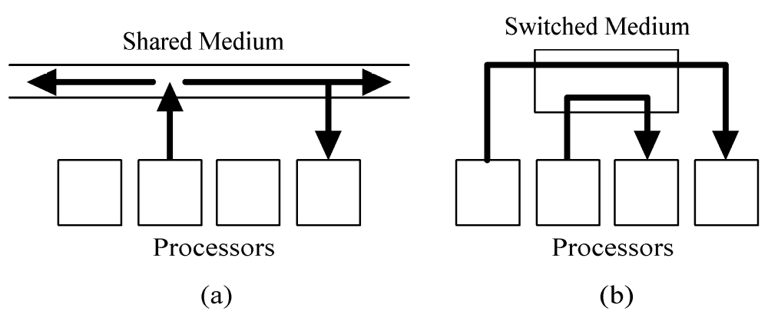
Shared versus Switched Media

Slide 6
Shared Medium
Allows only message at a time
Messages are broadcast
Each processor “listens” to every message
Arbitration is decentralized
Collisions require resending of messages
Ethernet is an example

Slide 7
Switched Medium
Supports point-to-point messages between pairs of processors
Each processor has its own path to switch
Advantages over shared media
  Allows multiple messages to be sent simultaneously
  Allows scaling of network to accommodate increase in processors

Slide 8
Switch Network Topologies
View switched network as a graph
  Vertices = processors or switches
  Edges = communication paths
Two kinds of topologies
  Direct
  Indirect

Slide 9
Direct Topology
Ratio of switch nodes to processor nodes is 1:1
Every switch node is connected to
  1 processor node
  At least 1 other switch node

Slide 10
Indirect Topology
Ratio of switch nodes to processor nodes is greater than 1:1
Some switches simply connect other switches

Slide 11
Evaluating Switch Topologies
Diameter
  Low is better
Bisection width
  High is better
Number of edges / node
  Best for constant
Constant edge length? (yes/no question)
  Best for independence of network size

Slide 12
2-D Mesh Network
Direct topology
Switches arranged into a 2-D lattice
Communication allowed only between neighboring switches
Variants allow wraparound connections between switches on edge of mesh

Slide 13
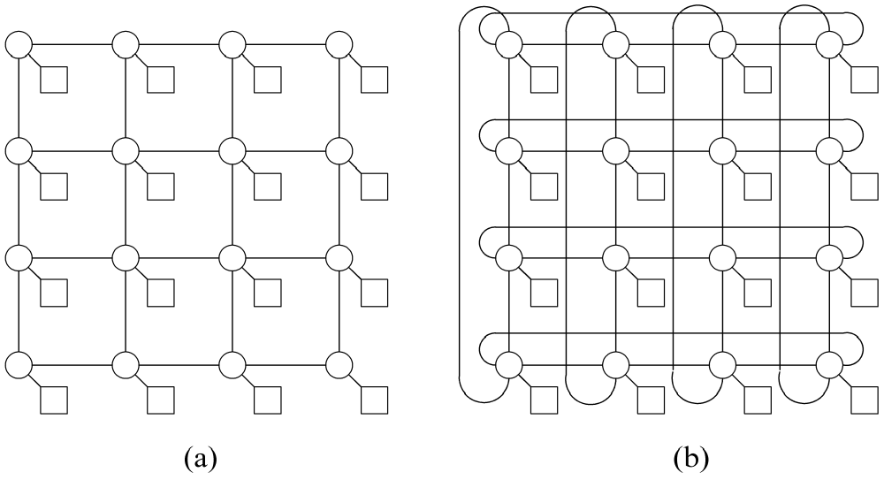
2-D Meshes
With wraparound connection

Slide 14
Evaluating 2-D Meshes
Diameter: Θ(n^{1/2})
Bisection width: Θ(n^{1/2})
Number of edges per switch: 4
Constant edge length? Yes

Slide 15
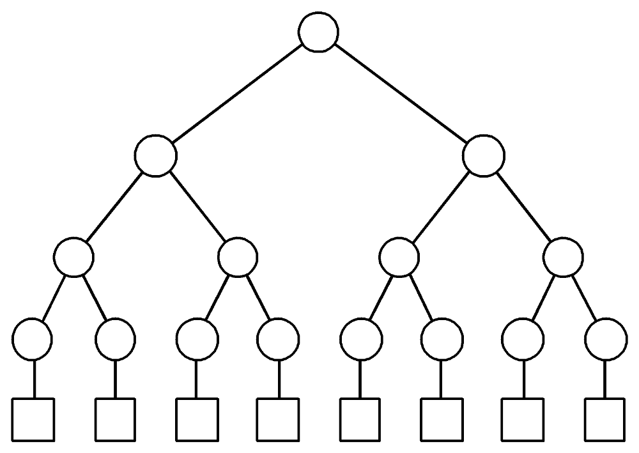
Binary Tree Network
Indirect topology
n = 2^{d} processor nodes, 2n-1 switches

Slide 16
Evaluating Binary Tree Network
Diameter: 2 log n
Bisection width: 1
Edges / node: 3
Constant edge length? No

Slide 17
Hypertree Network
Indirect topology
Shares low diameter of binary tree
Greatly improves bisection width
From “front” looks like k-ary tree of height d
From “side” looks like upside down binary tree of height d

Slide 18
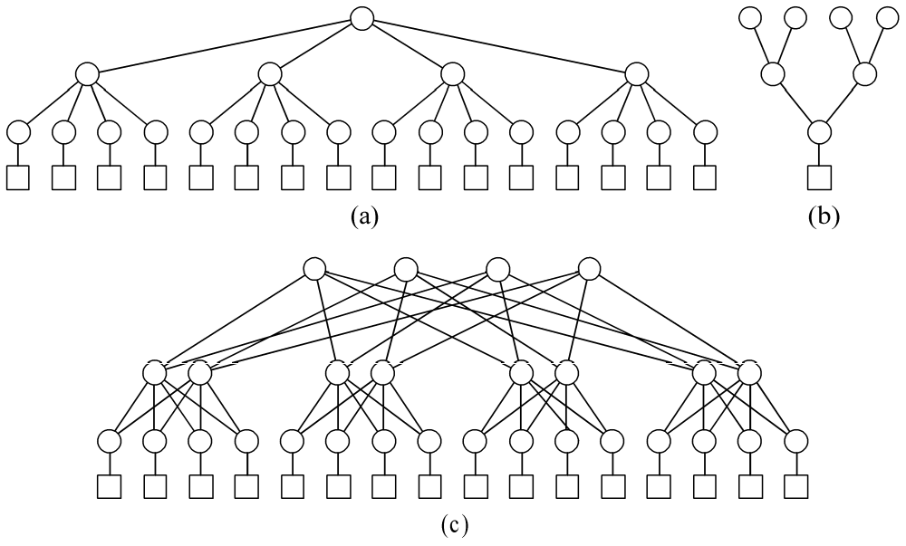
Hypertree Network
Front view
Side view
Complete network

Slide 19
Evaluating 4-ary Hypertree
Diameter: 2d=2log n
Bisection width: 2^{d+1}=2n
Edges / node: 6
Constant edge length? No

Slide 20
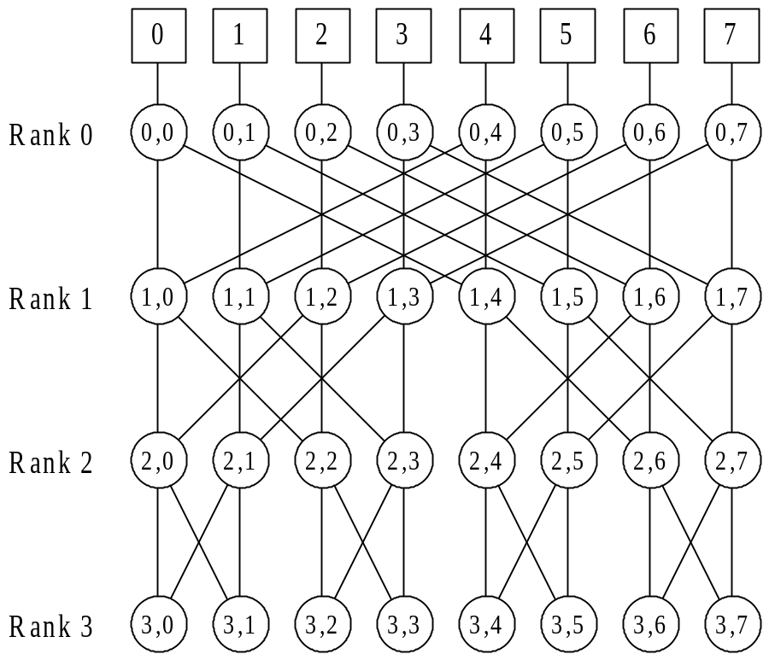
Butterfly Network
Indirect topology
n = 2^{d} processor
nodes connected
by n(log n + 1)
switching nodes

Slide 21
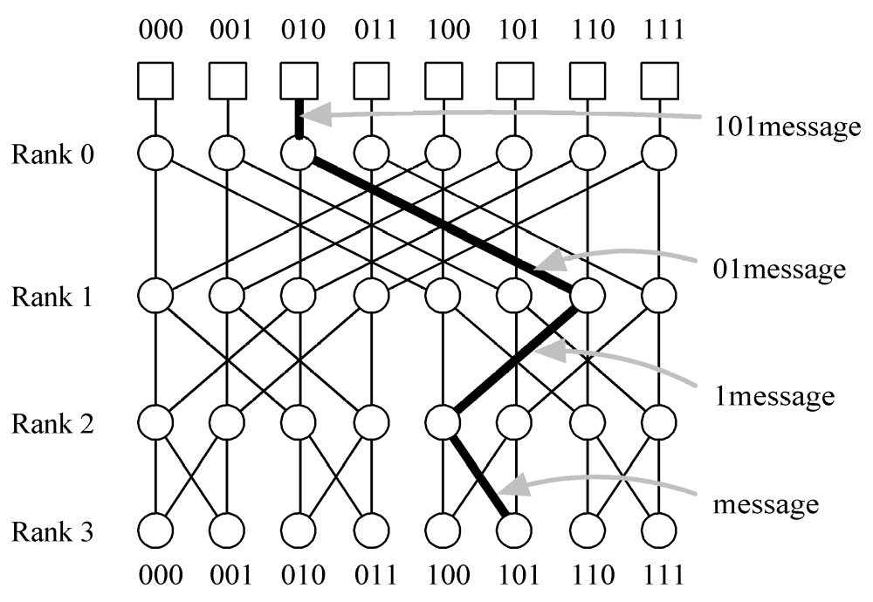
Butterfly Network Routing

Slide 22
Evaluating Butterfly Network
Diameter: log n
Bisection width: n (ref. errata)
Edges per node: 4
Constant edge length? No

Slide 23
Hypercube
Direct topology
2 × 2 × … × 2 mesh
Number of nodes a power of 2
Node addresses 0, 1, …, 2^{k}-1
Node i connected to k nodes whose addresses differ from i in exactly one bit position

Slide 24
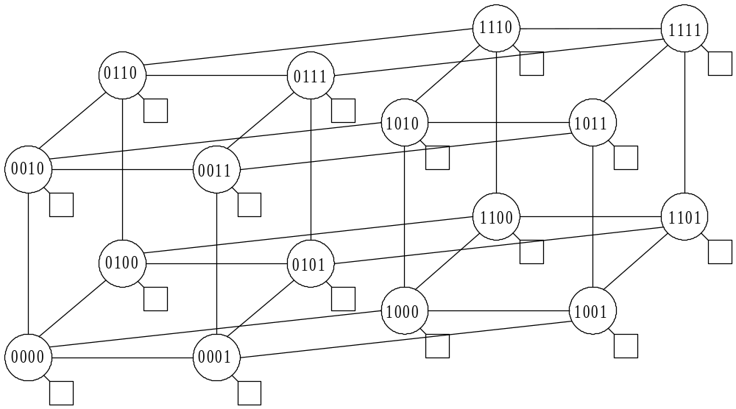
Hypercube Addressing

Slide 25
Hypercubes Illustrated

Slide 26
Evaluating Hypercube Network
Diameter: log n
Bisection width: n / 2
Edges per node: log n
Constant edge length? No

Slide 27
Shuffle-exchange
Direct topology
Number of nodes a power of 2
Nodes have addresses 0, 1, …, 2^{k}-1
Two outgoing links from node i
  Shuffle link to node LeftCycle(i)
  Exchange link to node [xor (i, 1)]

Slide 28
Shuffle-exchange Illustrated
0
1
2
3
4
5
6
7

Slide 29
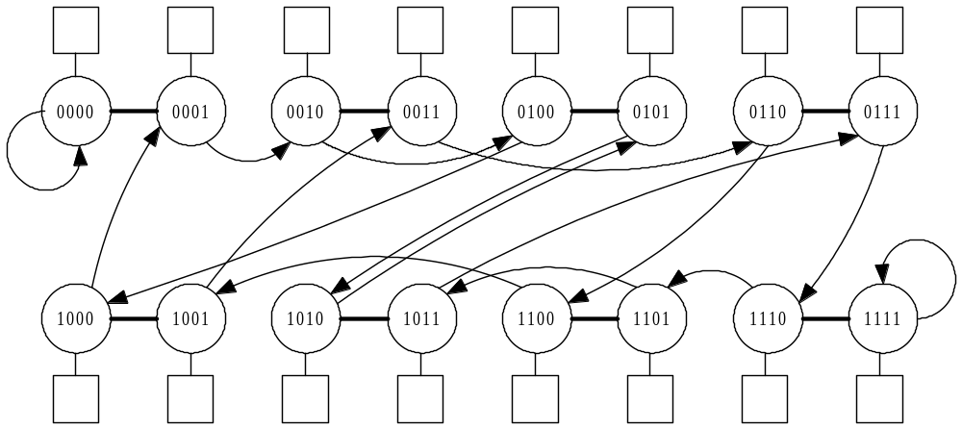
Shuffle-exchange Addressing

Slide 30
Evaluating Shuffle-exchange
Diameter: 2log n – 1
Bisection width: ≈ n / log n
Edges per node: 2
Constant edge length? No

Slide 31
Comparing Networks
All have logarithmic diameter
except 2-D mesh
Hypertree, butterfly, and hypercube have bisection width n / 2
All have constant edges per node except hypercube
Only 2-D mesh keeps edge lengths constant as network size increases

Slide 32
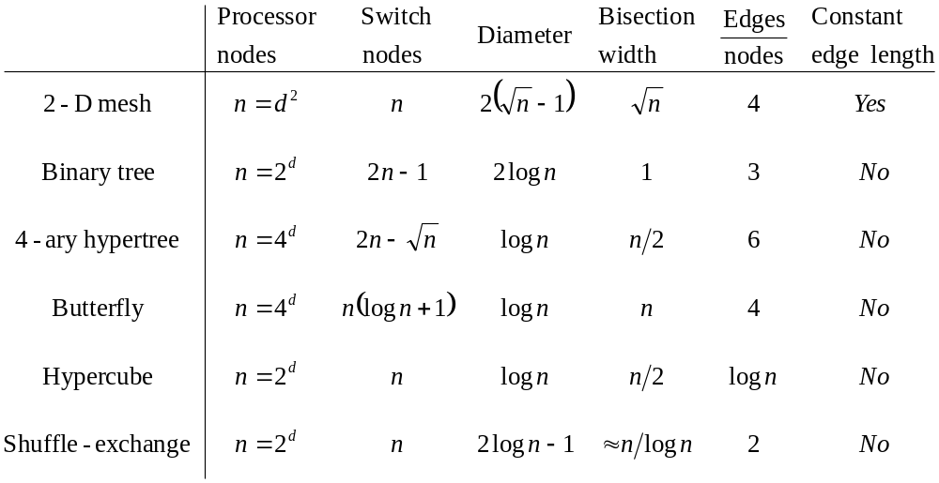
Summary

Slide 33
Vector Computers
Vector computer: instruction set includes operations on vectors as well as scalars
Two ways to implement vector computers
  Pipelined vector processor: streams data through pipelined arithmetic units
  Processor array: many identical, synchronized arithmetic processing elements

Slide 34
Why Processor Arrays?
Historically, high cost of a control unit
Scientific applications have data parallelism

Slide 35
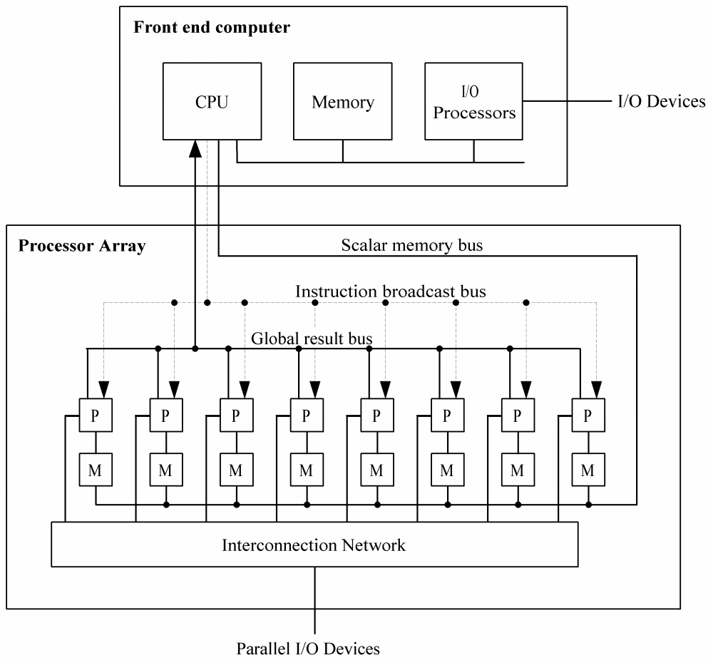
Processor Array

Slide 36
Data/instruction Storage
Front end computer
  Program
  Data manipulated sequentially
Processor array
  Data manipulated in parallel

Slide 37
Processor Array Performance
Performance: work done per time unit
Performance of processor array
  Speed of processing elements
  Utilization of processing elements

Slide 38
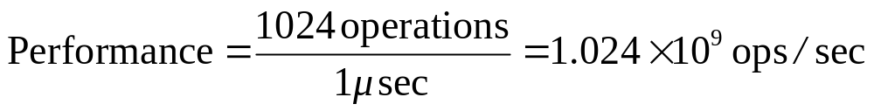
Performance Example 1
1024 processors
Each adds a pair of integers in 1 μsec
What is performance when adding two 1024-element vectors (one per processor)?

Slide 39
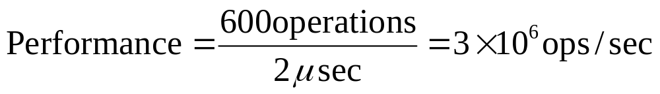
Performance Example 2
512 processors
Each adds two integers in 1 μsec
Performance adding two vectors of length 600?

Slide 40
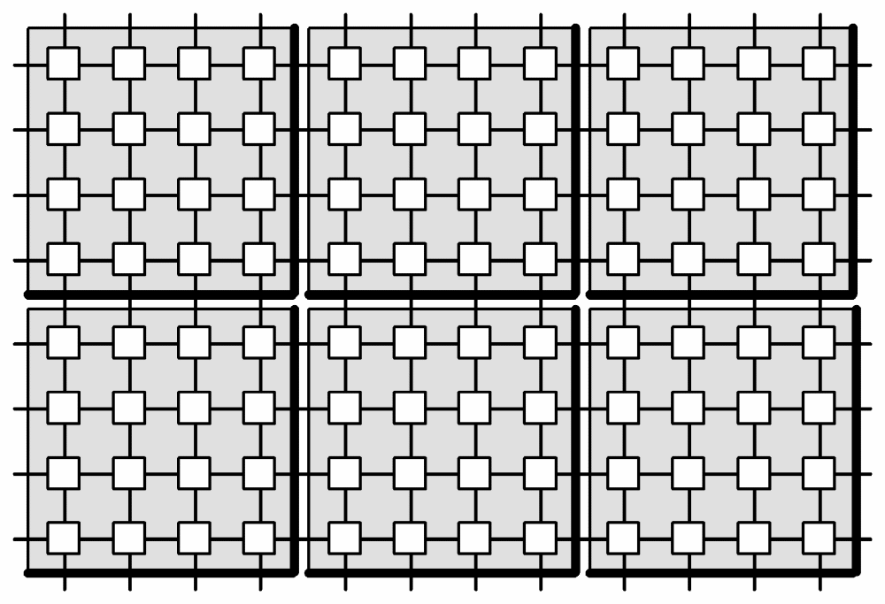
2-D Processor Interconnection Network
Each VLSI chip has 16 processing elements

Slide 41
if (COND) then A else B

Slide 42
if (COND) then A else B

Slide 43
if (COND) then A else B

Slide 44
Processor Array Shortcomings
Not all problems are data-parallel
Speed drops for conditionally executed code
Don’t adapt to multiple users well
Do not scale down well to “starter” systems
Rely on custom VLSI for processors
Expense of control units has dropped

Slide 45
Multiprocessors
Multiprocessor: multiple-CPU computer with a shared memory
Same address on two different CPUs refers to the same memory location
Avoid three problems of processor arrays
  Can be built from commodity CPUs
  Naturally support multiple users
  Maintain efficiency in conditional code

Slide 46
Centralized Multiprocessor
Straightforward extension of uniprocessor
Add CPUs to bus
All processors share same primary memory
Memory access time same for all CPUs
  Uniform memory access (UMA) multiprocessor
  Symmetrical multiprocessor (SMP)

Slide 47
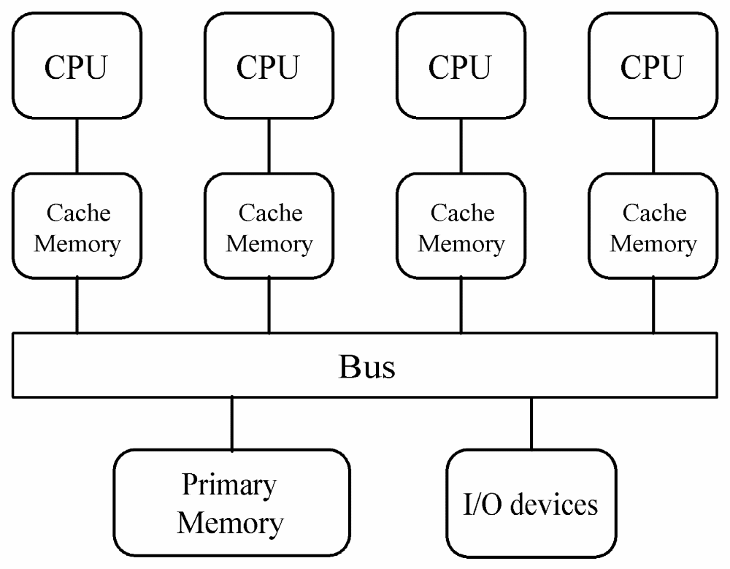
Centralized Multiprocessor

Slide 48
Private and Shared Data
Private data: items used only by a single processor
Shared data: values used by multiple processors
In a multiprocessor, processors communicate via shared data values

Slide 49
Problems Associated with Shared Data
Cache coherence
  Replicating data across multiple caches reduces contention
  How to ensure different processors have same value for same address?
Synchronization
  Mutual exclusion
  Barrier

Slide 50
Cache-coherence Problem (1)
Memory
X
7
Cache
Cache
CPU A
CPU B

Slide 51
Cache-coherence Problem (2)
Memory
X
7
7
CPU A
CPU B

Slide 52
Cache-coherence Problem (3)
Memory
X
7
7
7
CPU A
CPU B

Slide 53
Cache-coherence Problem (3)
Memory
X
2
2
7
CPU A
CPU B

Slide 54

Write Invalidate Protocol (1)
X
7
7
Cache control monitor
7
CPU A
CPU B

Slide 55
Write Invalidate Protocol (2)
X
7
Intent to write X
7
7
CPU A
CPU B

Slide 56
Write Invalidate Protocol (3)
X
7
Intent to write X
7
CPU A
CPU B

Slide 57
Write Invalidate Protocol (4)
X
2
2
CPU A
CPU B

Slide 58
Distributed Multiprocessor
Distribute primary memory among processors
Increase aggregate memory bandwidth and lower average memory access time
Allow greater number of processors
Also called non-uniform memory access (NUMA) multiprocessor

Slide 59
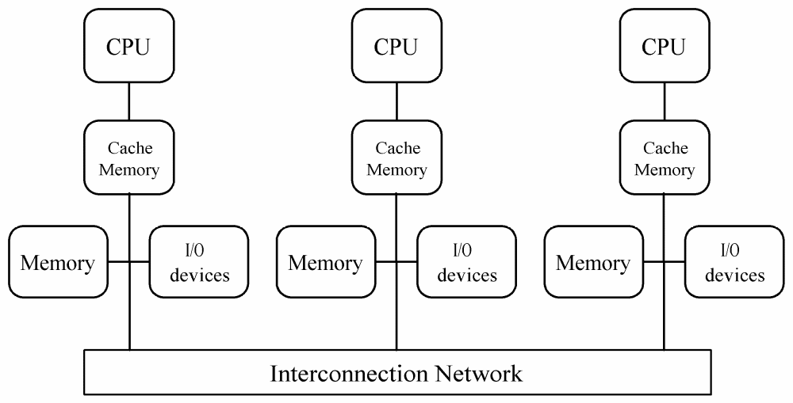
Distributed Multiprocessor

Slide 60
Cache Coherence
Some NUMA multiprocessors do not support it in hardware
  Only instructions, private data in cache
  Large memory access time variance
Implementation more difficult
  No shared memory bus to “snoop”
  Directory-based protocol needed

Slide 61
Directory-based Protocol
Distributed directory contains information about cacheable memory blocks
One directory entry for each cache block
Each entry has
  Sharing status
  Which processors have copies

Slide 62
Sharing Status
Uncached
  Block not in any processor’s cache
Shared
  Cached by one or more processors
  Read only
Exclusive
  Cached by exactly one processor
  Processor has written block
  Copy in memory is obsolete

Slide 63
Directory-based Protocol
Interconnection Network
Directory
Directory
Directory
Local Memory
Local Memory
Local Memory
Cache
Cache
Cache
CPU 0
CPU 1
CPU 2

Slide 64
Directory-based Protocol
Interconnection Network
Bit Vector
X
U 0 0 0
Directories
Memories
X
7
Caches
CPU 0
CPU 1
CPU 2

Slide 65
CPU 0 Reads X
Interconnection Network
Read Miss
X
U 0 0 0
Directories
Memories
X
7
Caches
CPU 0
CPU 1
CPU 2

Slide 66
CPU 0 Reads X
Interconnection Network
X
S 1 0 0
Directories
Memories
X
7
Caches
CPU 0
CPU 1
CPU 2

Slide 67
CPU 0 Reads X
Interconnection Network
X
S 1 0 0
Directories
Memories
X
7
Caches
X
7
CPU 0
CPU 1
CPU 2

Slide 68
CPU 2 Reads X
Interconnection Network
X
S 1 0 0
Directories
Memories
X
7
Read Miss
Caches
X
7
CPU 0
CPU 1
CPU 2

Slide 69
CPU 2 Reads X
Interconnection Network
X
S 1 0 1
Directories
Memories
X
7
Caches
X
7
CPU 0
CPU 1
CPU 2

Slide 70
CPU 2 Reads X
Interconnection Network
X
S 1 0 1
Directories
Memories
X
7
Caches
X
7
X
7
CPU 0
CPU 1
CPU 2

Slide 71
CPU 0 Writes 6 to X
Interconnection Network
Write Miss
X
S 1 0 1
Directories
Memories
X
7
Caches
X
7
X
7
CPU 0
CPU 1
CPU 2

Slide 72
CPU 0 Writes 6 to X
Interconnection Network
X
S 1 0 1
Directories
Invalidate
X
7
Memories
Caches
X
7
X
7
CPU 0
CPU 1
CPU 2

Slide 73
CPU 0 Writes 6 to X
Interconnection Network
X
E 1 0 0
Directories
Memories
X
7
Caches
X
6
CPU 0
CPU 1
CPU 2

Slide 74
CPU 1 Reads X
Interconnection Network
Read Miss
X
E 1 0 0
Directories
Memories
X
7
Caches
X
6
CPU 0
CPU 1
CPU 2

Slide 75
CPU 1 Reads X
Interconnection Network
Switch to Shared
X
E 1 0 0
Directories
Memories
X
7
Caches
X
6
CPU 0
CPU 1
CPU 2

Slide 76
CPU 1 Reads X
Interconnection Network
X
E 1 0 0
Directories
Memories
X
6
Caches
X
6
CPU 0
CPU 1
CPU 2

Slide 77
CPU 1 Reads X
Interconnection Network
X
S 1 1 0
Directories
Memories
X
6
Caches
X
6
X
6
CPU 0
CPU 1
CPU 2

Slide 78
CPU 2 Writes 5 to X
Interconnection Network
X
S 1 1 0
Directories
Memories
Write Miss
X
6
Caches
X
6
X
6
CPU 0
CPU 1
CPU 2

Slide 79
CPU 2 Writes 5 to X
Interconnection Network
Invalidate
X
S 1 1 0
Directories
Memories
X
6
Caches
X
6
X
6
CPU 0
CPU 1
CPU 2

Slide 80
CPU 2 Writes 5 to X
Interconnection Network
X
E 0 0 1
Directories
Memories
X
6
Caches
X
5
CPU 0
CPU 1
CPU 2

Slide 81
CPU 0 Writes 4 to X
Interconnection Network
X
E 0 0 1
Directories
Memories
X
6
Caches
X
5
CPU 0
CPU 1
CPU 2

Slide 82
CPU 0 Writes 4 to X
Interconnection Network
X
E 1 0 0
Directories
Memories
Take Away
X
6
Caches
X
5
CPU 0
CPU 1
CPU 2

Slide 83
CPU 0 Writes 4 to X
Interconnection Network
X
E 1 0 0
Directories
Memories
X
5
Caches
X
5
CPU 0
CPU 1
CPU 2

Slide 84
CPU 0 Writes 4 to X
Interconnection Network
X
E 1 0 0
Directories
Memories
X
5
Caches
CPU 0
CPU 1
CPU 2

Slide 85
CPU 0 Writes 4 to X
Interconnection Network
X
E 1 0 0
Directories
Memories
X
5
Caches
X
5
CPU 0
CPU 1
CPU 2

Slide 86
CPU 0 Writes 4 to X
Interconnection Network
X
E 1 0 0
Directories
Memories
X
5
Caches
X
4
CPU 0
CPU 1
CPU 2

Slide 87
CPU 0 Writes Back X Block
Interconnection Network
Data Write Back
X
E 1 0 0
Directories
X
X
5
Memories
4
Caches
X
4
CPU 0
CPU 1
CPU 2

Slide 88
CPU 0 Writes Back X Block
Interconnection Network
X
U 0 0 0
Directories
Memories
X
4
Caches
CPU 0
CPU 1
CPU 2

Slide 89
Multicomputer
Distributed memory multiple-CPU computer
Same address on different processors refers to different physical memory locations
Processors interact through message passing
Commercial multicomputers
Commodity clusters

Slide 90
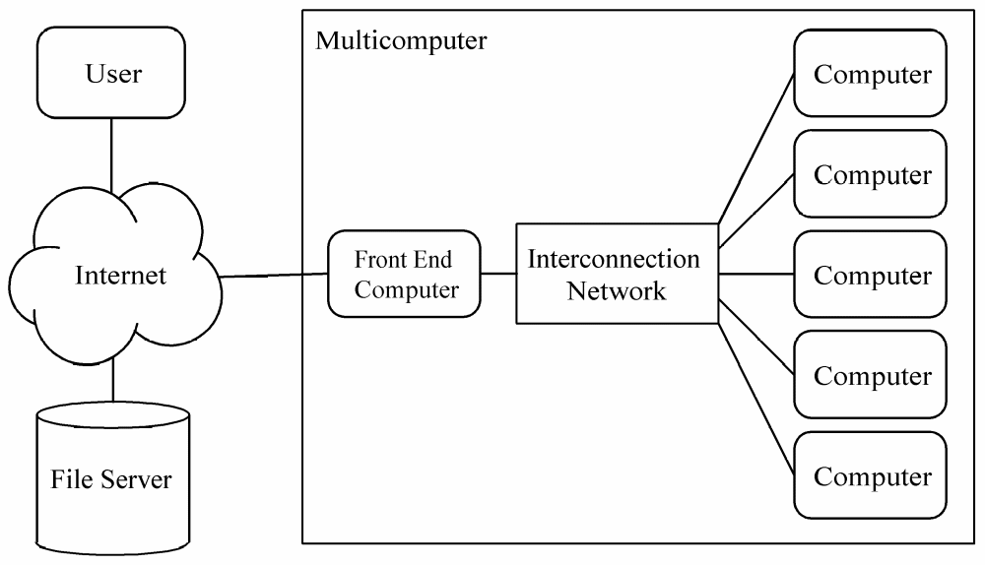
Asymmetrical Multicomputer

Slide 91
Asymmetrical MC Advantages
Back-end processors dedicated to parallel computations ⇒ Easier to understand, model, tune performance
Only a simple back-end operating system needed ⇒ Easy for a vendor to create

Slide 92
Asymmetrical MC Disadvantages
Front-end computer is a single point of failure
Single front-end computer limits scalability of system
Primitive operating system in back-end processors makes debugging difficult
Every application requires development of both front-end and back-end program

Slide 93
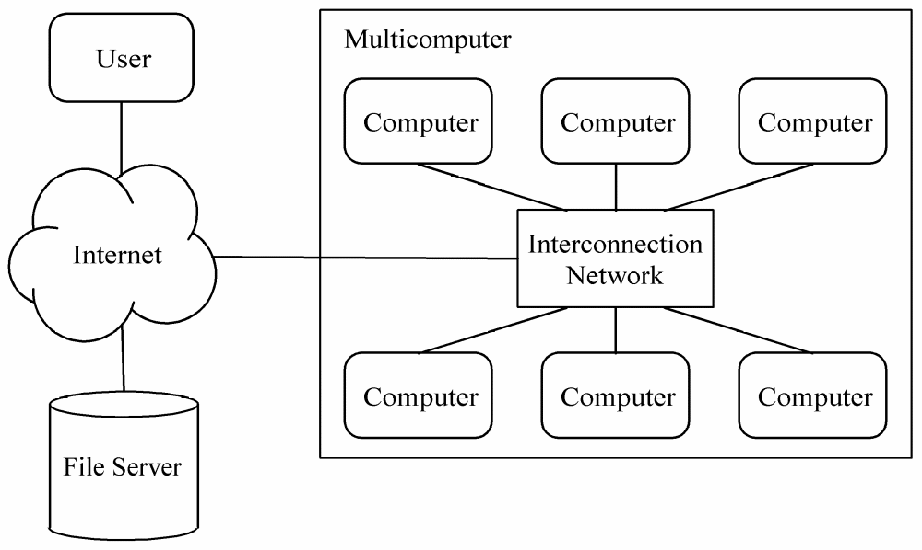
Symmetrical Multicomputer

Slide 94
Symmetrical MC Advantages
Alleviate performance bottleneck caused by single front-end computer
Better support for debugging
Every processor executes same program

Slide 95
Symmetrical MC Disadvantages
More difficult to maintain illusion of single “parallel computer”
No simple way to balance program development workload among processors
More difficult to achieve high performance when multiple processes on each processor

Slide 96
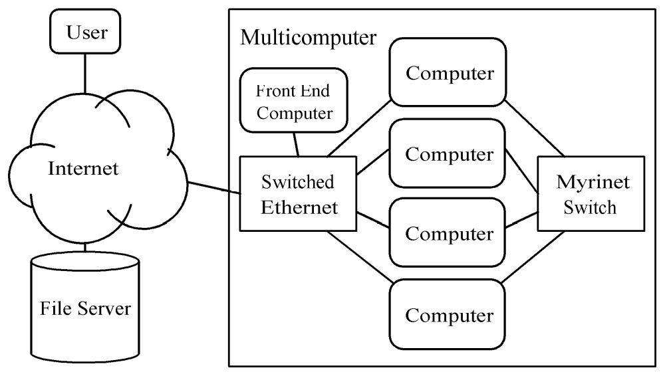
ParPar Cluster, A Mixed Model

Slide 97
Commodity Cluster
Co-located computers
Dedicated to running parallel jobs
No keyboards or displays
Identical operating system
Identical local disk images
Administered as an entity

Slide 98
Network of Workstations
Dispersed computers
First priority: person at keyboard
Parallel jobs run in background
Different operating systems
Different local images
Checkpointing and restarting important

Slide 99
Flynn’s Taxonomy
Instruction stream
Data stream
Single vs. multiple
Four combinations
  SISD: uniprocessors
  SIMD: proc arrays, pipelined vector procs
  MISD: Systolic arrays
  MIMD: multiprocessor, multicomputers

Slide 100
SISD
Single Instruction, Single Data
Single-CPU systems
Note: co-processors don’t count
  Functional
  I/O
Example: PCs

Slide 101
SIMD
Single Instruction, Multiple Data
Two architectures fit this category
  Pipelined vector processor
  (e.g., Cray-1)
  Processor array
  (e.g., Connection Machine)

Slide 102
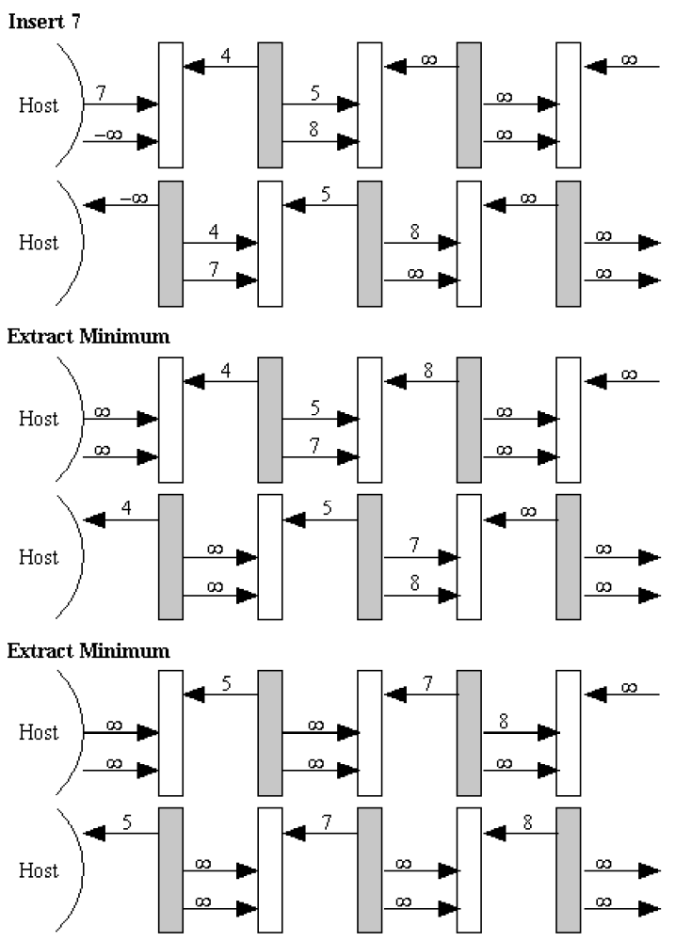
MISD
Multiple
Instruction,
Single Data
Example:
systolic array

Slide 103
MIMD
Multiple Instruction, Multiple Data
Multiple-CPU computers
  Multiprocessors
  Multicomputers

Slide 104
Summary
Commercial parallel computers appeared
in 1980s
Multiple-CPU computers now dominate
Small-scale: Centralized multiprocessors
Large-scale: Distributed memory architectures (multiprocessors or multicomputers)

Slide 105
Exercise 2
2.14
2.19

